Slide 1
Data Management & Data Virtualization with Cloud Pak for Data

Slide 2
Legal Disclaimer
© IBM Corporation 2020. All Rights Reserved.
The information contained in this publication is provided for informational purposes only. While efforts were made to verify the completeness and accuracy of the information contained in this publication, it is provided AS IS without warranty of any kind, express or implied. In addition, this information is based on IBM’s current product plans and strategy, which are subject to change by IBM without notice. IBM shall not be responsible for any damages arising out of the use of, or otherwise related to, this publication or any other materials. Nothing contained in this publication is intended to, nor shall have the effect of, creating any warranties or representations from IBM or its suppliers or licensors, or altering the terms and conditions of the applicable license agreement governing the use of IBM software.
References in this presentation to IBM products, programs, or services do not imply that they will be available in all countries in which IBM operates. Product release dates and/or capabilities referenced in this presentation may change at any time at IBM’s sole discretion based on market opportunities or other factors, and are not intended to be a commitment to future product or feature availability in any way. Nothing contained in these materials is intended to, nor shall have the effect of, stating or implying that any activities undertaken by you will result in any specific sales, revenue growth or other results.
All customer examples described are presented as illustrations of how those customers have used IBM products and the results they may have achieved. Actual environmental costs and performance characteristics may vary by customer.

Slide 3

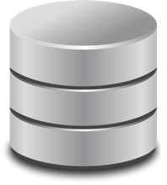







Data is Everywhere
Number of Sources and volume rapidly increasing
More and more heterogeneous
Highly distributed – internal and external

Slide 4
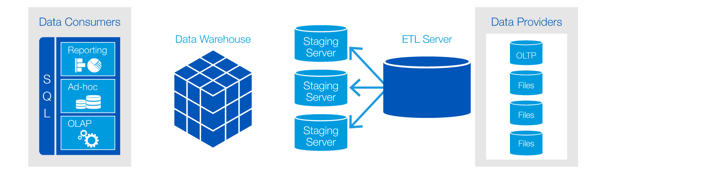
Traditional Data Integration is insufficient today
Risk to data security
Data inconsistency & error prone
Rigid and limits business agility
High cost and latency
Finite scalability
Not Viable to continue to Move or Copy all Data (using extract, transform, load ETL)

Slide 5
Current Data Architectures
Numerous ETLs
Unnecessary duplication and data replication as business users demand more data views
Data governance issues accelerating across the enterprise
Physics have driven Cost & Complexity
And impede Productivity

Slide 6

A Single View for Self-Service
Study Reference : “From Data to Insight: Work Practices of Analysts in the Enterprise”, Kandogan, Balakrishnan, Haber, Pierce, submitted to IEEE Computer Graphics and Applications, Special Issue on Business Intelligence Analytics
The growth of Big Data compounds complexity, resulting in an increase in friction that already exists between IT and business consumption
Studies report friction between elements of the ecosystem lead to major inefficiencies.
Real-time data access for real-time decisions
Finding data is hard
Need metadata for lineage, quality, currency
Need for virtualized access to persistent data

Slide 7
What is Data Virtualization? The ability to view, access, manipulate and analyze data without the need to know or understand its physical format or location, and without having to move or copy it.

Slide 8
What is the value proposition ?

Slide 9

What if you could tap into all of your critical data assets no matter where they physically are?
What if you could query 2 or 2,000 data systems with a single query?

Slide 10
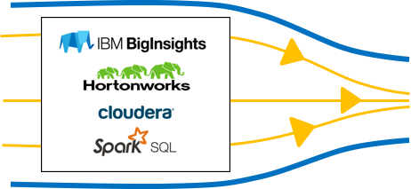
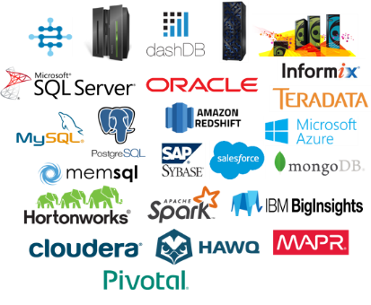
Data virtualization key Use Cases
Driven by patterns needing low data latency, high flexibility with transient schema
On-demand Virtual Data Marts to save cost of standing up EDW
EDW prototyping and migration (mergers/acquisitions)
Virtualization with Big Data (Hadoop, NoSQL, and Data Science)
EDW augmentation (offload workload)
Data discovery for ”what if” scenarios across hybrid platforms
Data Caching of combined data for frequently accessed data
Combine MDM with IoT for Systems of Insight (IT/OT)
Data integration preparation tool to complement ETL
Master data hub extension to enrich 360 View (e.g. multi-channel CRM)
single View across your business
real-time analytics without moving data
fast TTV with high ROI

Slide 11
How does it work ?

Slide 12
Some Definitions
Data Federation - technology
Federation is the underlying approach for defining access/authorization to logically mapped remote data sources and query technology used for the execution of distributed query processing against multiple data sources.
Data Virtualization - platform
Any approach to data management that allows an application to retrieve and manipulate data without requiring technical details about the data, such as how it is formatted at source, or where it is physically located, and can provide a single customer view of the overall data. Typically necessitates a platform or information architecture. (Data Federation is embedded)
Data Integration enhanced
Data integration solutions traditionally move a copy of the data from disparate sources into a new consolidated source. Data Virtualization complements by providing a view of the integrated data while leaving the source data exactly where it is.

Slide 13
IBM Data Virtualization
Query across multiple data sources:
Oracle, Db2, SQLServer, Informix, Netezza, MySQL, PostgreSQL, Big SQL, Apache Hive, HDP Hive, Cloudera Impala and more!
Rich application capabilities
Connect to Data Virtualization with your favorite SQL apps and tools
RStudio, Jupyter Notebook, Cognos, Tableau, Microstrategy
Scale! 1 or 1,000 at once
More than 10x better for several important use cases
Secure!
Strict access controls
Fully encrypted communications.
Schema discovery and folding
Automatically find and match tables across systems so you can query them as a single virtual table.
Deeply integrated w Cloud Pak for Data
Enterprise Data Catalog, governance and security. e.g. Automatic publishing of virtualized data into the data catalog.
Immediate access via Cognos and Watson Studio

Slide 14
Data Virtualization in Cloud Pak for Data
The ability to view, access, manipulate and analyze data without the need to know or understand its physical format or location, and without having to move or copy it.
Analytics Tools
Portals
Web Services
Applications
Mobile Apps
Consumers
Governance Catalog
(Metadata)
Consumer Layer
(Interface Provisioning)
Business Terms
Data Privacy &
Protection Rules
Lineage
Virtualization Layer
Virtualization
Platform
Caching &
Optimization
Connection Layer
(Adaptors)
Lakes
NoSQL
Warehouses
Files
Marts
Web
Services
Data Sources
Cloud
Applications

Slide 15
Key Architectural Differentiation
Hub and spoke execution models:
Lacks scalability
Performance constrained
Basis for Federation and our competitors
IBM is first to market with a parallel processing model:
Theoretically unlimited scalability
Ease of addition/removal of sources
Execution pushed down into the constellation mesh
Hub and Spoke Model
coordinator
Query
Query Result
Query issued against the system
A coordinator receives the request and fans the work out to edge nodes
Edge nodes individually perform as much work as they can based on their own data. Individual results are sent back to the coordinator for final merging and remaining analytics.
Coordinator receives intermediary results from all edge nodes, merges results, and performs remaining analytics
New Computational Mesh
coordinator
Query
Query Result
Query issued against the system
A coordinator receives the request and fans the work out to edge nodes
Edge nodes self organize into a constellation where they can communicate with a small number of peers. Nodes collaborate to perform almost all analytics, not only analytics on their own data.
Coordinator receives mostly finalized results from just a fraction of nodes. Completes the final work for the query result.

Slide 16



IBM’s Unique Approach to Data Virtualization
Parallel processing mesh providing execution performance and scalability:
Quickly deliver analytics results and easily evolve with new data source demands
Service Cluster scalability and Enterprise robustness:
Reliability and ability to quickly adapt to increasing business demand
Governance Integration and Security:
Controlled, governed and secure access to virtual data sets within the Cloud Pak for Data Platform
Common SQL engine, rich set of SQL dialects, application portability
Retain the use of existing applications and tools within the business
Richness of automation and discovery of Data:
Enable more self service and increase productivity (while retaining access control)
Underlying platform flexibility with Cloud Pak for Data:
Grow or move your Analytics and Virtualization platform with any environment
Constellation
Data Sources
Service
Cluster
Analytics / ML
Application
Caching
Policy

Slide 17
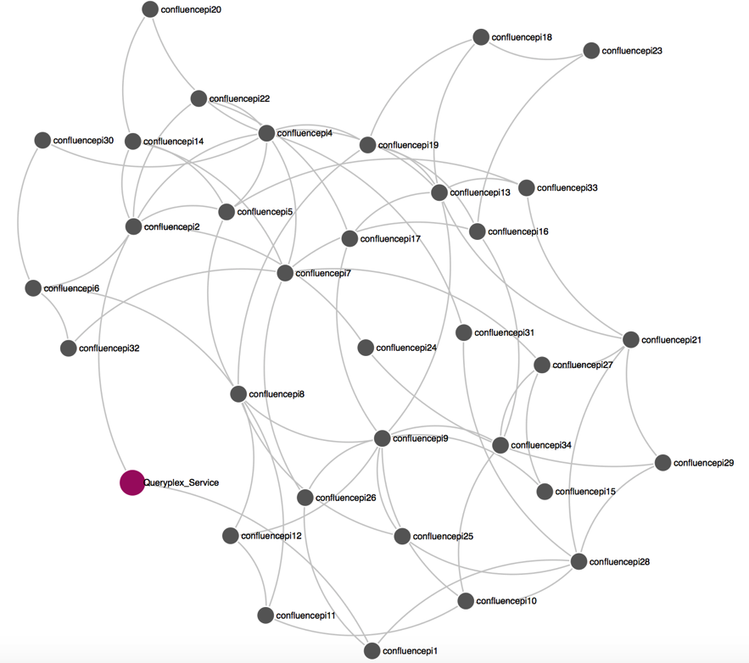
Creating the Constellation
Small packet of Data Virtualization software deployed on each data node, approximately 50MB.
Automatic dynamic and resilient organization of data sources.
Query compiler builds a collaborative query plan, forcing the nodes to collaborate

Slide 18
Cloud Pak for Data (Nov 2019) | In the roadmap pipeline
Db2 family for HDM Db2 for iSeries, zSeries Db2 for z/OS Big SQL IIAS, PDA (Netezza) Informix Derby Oracle SQL Server MySQL PostgreSQL Apache Hive, HDP Hive Cloudera Impala Teradata* MongoDB Hive Excel, CSV, Text* Sybase MariaDB Snowflake Z Data Sources through IBM DVM Integration VSAM, IMS, CICS, Adabas Map-R (Hive) | BigQuery ( patch in 2019, GA Q1, 20) SAP HANA SAP BW Amazon Redshift Salesforce SAS Interbase Apache Drill Amazon Dynamo, Aurora Generic use of any JDBC access CouchDB Stream / MQ Apache Spark SQL Apache Kafka Cloudant Pivotal Greenplum Cassandra
Broad support for common data source types
More to be added in the future.
Note - IBM’s statements regarding its plans, directions, and intent are subject to change or withdrawal without notice at IBM’s sole discretion.
Notes:
Clients Ask -
Employer -
Mongo – Atlas service ( AWS)
Postgres ( AWS)
Oracle
Hana ( multiple)
Interbase (farmercompanies - Bob, Gary)

Slide 19
Thank you

Slide 20
Data Virtualization Manager for z/OS

Slide 21
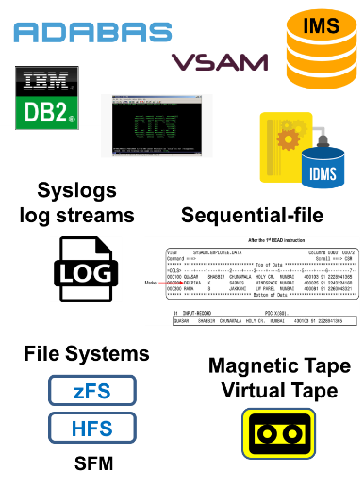
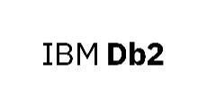





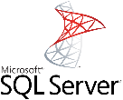


Data Virtualization Manager for z/OS
More than 35 supported data sources
IBM Z
Non-IBM Z
Family, Informix
CA IDMS
Systems Management Facility
SMF
Data for
IT Operational
Analytics
Other DBs
20+ DRDA data sources
... exposed to data consumers
in SQL (JDBC/ODBC/DRDA) and NoSQL (JSON) formats
Notes:
Partial list of supported data sources
Data support Data source
Mainframe relational/non-relational databases and file structures
- IBM® DB2
- IBM® Information Management System
(IMS/DB)
- Native VSAM files
- Sequential files
- Software AG Adabas
Mainframe applications and screens - IBM® CICS®
- IDMS
- IBM® Information Management System
- Software AG Natural
- VSAM via IBM® CICS® Transaction Server
- IBM Rational Asset Analyzer (RAA)
Distributed data stores running on Linux, UNIX, and Windows platforms
- IBM® BigInsights Hadoop
- IBM® DB2
- Apache Derby
- IBM® Informix
- Oracle
- Microsoft SQL Server
- IBM Application Discovery and Delivery Intelligence (ADDI)

Slide 22
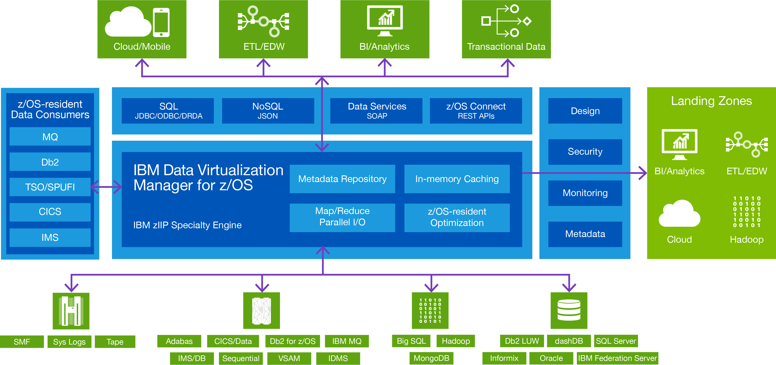
IBM Data Virtualization Manager for z/OS
NEW!
Z15 Exploitation!
ETL/ Enterprise Data Warehouse
JGATE Server
Postgres
Model 204
Teradata
Cassandra
+
Notes:
zIIP eligible / avoid MLC costs
Optimized for z14, z13, EC12
Supports relational sources
Support any API: SQL, NoSQL, REST, SOAP, HTTP
Python support
Automated discovery though IBM ADDI
Ships with industry mappings
Exploits 64-bit storage
Built-in MapReduce
Built-in parallel I/O

Slide 23
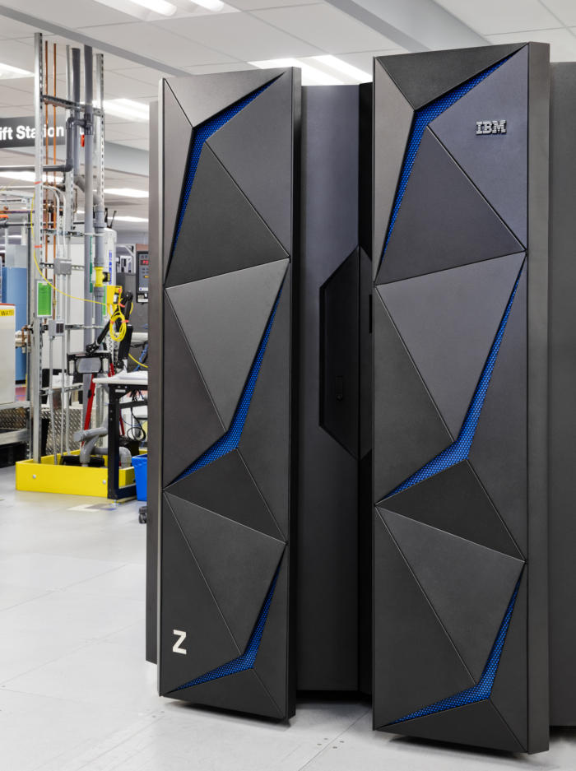
DVM for z/os Use Cases
Expand Db2 applications beyond just Db2
New features making Db2 as the Datahub for non-Db2 data sources
”Any Db2 application to any data”
Large Insurance company
Providing z data for testing scenarios
DVM enabled customer’s dev tool to access IMS
Multi-national Telecomm company
Creating a virtual data lake
System of record data stayed on z reducing ETL
Inventory information located across continents is virtualized with DVM
Multi-national Automotive company
Modernization with DVM and z/os Connect
DVM used to provide Rest access to z/os data (VSAM, IMS, etc) as well as Db2 z
DVM used to access IMS data directly as backup to unstable data warehouse on distributed platform
Global Airline
Shrinking app dev cycle with DVM and ETL
No win situation with ETL (customer politics and deep investment)
Large Financial
Improving data access to aircraft maintenance records
4 hr ETL process to Oracle ODS reduced
DVM showed no significant increase in resource utilization on z
PoC showed accessing IMS data in place as a good option over data movement
Global Airline
IBM’s Classic Federation Upsell
5x the performance in PoC (Bank)
Classic Fed no longer being enhanced
Migration plan being developed by Rocket - - available soon
Notes:
Here are additional use cases – more detail in addendum.

Slide 24

Make Data Simple & Accessible
Global Automobile Manufacturer: Creates a virtual data lake with Hadoop
BEFORE
AFTER
z data moved to feed Hadoop data lake
Moving the data was very costly
BI solutions used current non-Z data but stale, inaccurate IBM Z data
Applications provided inadequate responses or insights, increasing risk
All z data is accessed in place and federated with Hadoop data
Access is fast and cost-effective; >95% offload to zIIP lowered costs
BI Solutions and Z solutions can all see real time data
Applications produce risk free insights at a lower cost
Notes:
Challenge
Critical Vehicle ID (VID) ,vehicle parts, and dealership information reside in different platforms and heterogenous data formats.
The mainframe data is moved with ETL and this was costly and produced stale data
Cobol applications and BI tools do not have an integrated view of data without reliance on expensive and lengthy ETL processes
Applications gave inadequate or inaccurate responses because the data driving applications was old and therefore inaccurate. This increased risk
Solution
IBM’s Data Virtualization Manager (DVM) provided a federated view of data simplifying the ETL process.
DVM takes advantage of zIIP and in-memory processing to make the solution fast , low cost and risk free.
Key client benefit
DVM federated key VID (Vehicle ID) information on z with data on Hadoop to make data available for the data warehouse, reducing the need for ETL.
The Vehicle ID information on Z stayed as the system of record
DVM showed 95+% zIIP offload which hit the mark on CPU/resource savings requirement
With reducing the ETL, the federated view created by DVM is now available to Cobol and modern BI based applications providing access to real time data.
Applications produce insights that are current decreasing risk of making bad decisions, all at a lower cost

Slide 25
Cloud Pak for Data DV combined with DVM for z/os
Cloud Pak for Data DV and DVM integration
Extends the CPD DV service to the mainframe using DVM for z/OS
Provides seamless interface and access to ALL Z data
Auto-discovers z data, cataloging, (Gather/Manage, Understand, Govern)
Leverages real-time persisted data for analytics and ML using z data
Enables Developers and Business Users lacking mainframe skills
Reduces costs and complexity of ETL when working with z data
DVM connectivity with Integrated DRDA Facility, Db2 UDTF support (User Defined Table Function)
ALL DVM for z/os functions (read/write, API support, data sources support, exploitation of hardware (z15!) are available – no changes to DVM
Products for Z :
DVM for z/os (5698-DVM) – business as usual
Cloud pak for Data zPPA: D1YH6LL (Enterprise Edition) or D1ZXLLL (Native Edition)
Client already has DVM?
There is no change to their license. No additional cost..
Action: Sell Cloudpak for Data
Notes:
Mainframe data access made easy
Data virtualization on z/OS eliminates the complexity of working with mainframe resources. Using data virtualization, you can knit data from multiple, disconnected sources into a single logical data source, making it much easier to connect mainframe data with your distributed applications:
Use mainframe data in place—no mainframe skills required
Developers access data directly using familiar environments such as SQL
Integrate mainframe data and applications
Blend Mainframe data with other strategic assets across the enterprise
With data virtualization, you map mainframe data once to leverage it for multiple applications and all of the associated benefits. By documenting your institutional knowledge just once – the expertise of your mainframe DBAs and data experts – you open access to any developer and to any application in the future.
Combine mainframe data with relational, unstructured, social data
Data quality, lineage and governance
Leverage existing business policies
Accelerate digital transformation
Data Virtualization provides the real-time data essential to exploit new digital technologies, such as web, mobile, cloud, and real-time analytics. Data virtualization masks the underlying mainframe data implementations from the application developer, making it easy to expose mainframe assets as APIs that developers can use to incorporate data and transactions into mobile and cloud applications.
Improve developer productivity through SQL, Python, Jupyter Notebooks, Open R, ML algorithms
Unleash your highest-value data assets to the API economy
Streamline enterprise integration
Reduce cost/complexity of ETL
ETL and data warehousing—the state of the art for two decades—are now struggling to support the requirements of mobile, cloud, and analytics applications, along with today’s data volumes. Rocket Data Virtualization integrates with your existing data architecture as a faster, more cost-effective means of addressing data access needs.
Use less mainframe capacity while getting real-time data for applications
Optimize your existing ETL processes
Create a logical data warehouse
***************
Customer continues to use Full DVM licensing for reporting, data mining, blending across MF and relational data sources using the Mainframe domain as a launch point
Cloud Pak for Data includes the Rocket Driver for use with licensed DVM software
Cloud Pak for Data begins to Catalog DVM for zOS metadata and uses DV on Cloud Pak for Data to construct a Data Services Layer for business users to access that is 100% trusted, governed and curated for use.
Customer client requests can flow directly to DVM or Cloud Pak for Data depending on business requirements.
There is no additional cost associated with DVM to leverage Cloud Pak for Data.

Slide 26
IBM Data Virtualization Manager– Key Enhancements
Integrated DRDA Facility | Allows joining data from multiple data sources even when the data sources have different catalogs or are located across sysplexes. Example is joining data across IMS servers and VSAM catalogs that is spread out across sysplexes. Technology: A DVM Server can now connect to and access virtual data from one or many DVM servers. Data can be shared between DVM servers without being on the same Sysplex.
Db2 UDTF support (User Defined Table Function) | Allows any application to access any DVM virtualized data using DB2 via SQL. Ex: DB2 app accesses and updates VSAM records using SQL. Technology: DVM supports the creation of a Db2 UDTF on any virtualized object defined to a DVM server within any Db2 subsystem connected to DVM. Once the UDTF has been created any connection/application to Db2 can easily access this data using Db2’s SQl engine.
JAVA Gateway | Any JAVA application can access data without needing a JDBC driver to be purchased for the data source. Customers are using this to access Teradata, Postgres, Model 204 and Cassandra data. Technology: A DRDA application server can be placed on any system to access data via a JDBC driver and make it accessible to any application. Avoids dealing with OEM DB to drive DRDA support.

Slide 27
DEMO
What you’ll see
Introductory video (Luis – 6 min)
Data Virtualization over widely distributed data
SQL editor inside Cloud Pak for Data
Caching and Governance
Publishing the virtual objects to catalog
Associate business terms to virtual objects
Associate governance rule to virtual objects (allow/deny access)
How to define cache
Show cache usage graph (Use SQL editor + Any other tool like Tableau)
Remote connectors
Remote connector to files from Mac
Remote connector to Db’s using discovery

Slide 28
Data Virtualization Roadmap - @Jan 2020
1H
2020
2H
2020
ICP4D Continuous Delivery
Data Source Connectors to identify for Schema changes for DV Objects
Governance Enhancements for DV Objects
Business Terms mapping and classification for all newly discovered data columns of a new / changes to Data assets
Policy Enforcement :Phase 2 – Smart Masking
Lineage :Phase 2 - Horizontal and Vertical
Security : DV role access control enhancement- Group level Authentication /Authorization
Smart Data Caching for better Perf with Policy definition, management, incremental caching of large datasets
Additional Data Source Support
Market Based Decision
Monitoring enhancements
ICP4D Continuous Delivery
RESTful API for Virtual Object creation and updates / Other RESTful API based on market needs
Workload / Policy Management
As an admin define user / resource prioritization for workload
Additional Data Source Support
Market Based Decision
NLP Query Editor
Data Write Back capability
Write to staging area
Data Write Back capability
Ability to write the transformed data back to the source from which the data was initially extracted
High Availability of Service Node
Data Lifecycle Management
Organizing data between tiers based on policy
Automatic migration of data between tiers
Note - IBM’s statements regarding its plans, directions, and intent are subject to change or withdrawal without notice at IBM’s sole discretion.
Notes:
DV as the only Governed data access plane of CPD
Parallel processing mesh providing execution performance and scalability:
Quickly deliver analytics results and easily evolve with new data source demands
Central Node scalability and Enterprise robustness (via an HA cluster):
Reliability and ability to quickly adapt to increasing business demand
Governance Integration and Security:
Controlled, managed and secure access to virtual data
Common SQL engine, rich set of SQL dialects, application portability
Retain the use of existing applications and tools within the business
Richness of automation and discovery of Data:
Enable more self service and increase productivity (while retaining access control)
Underlying platform flexibility with ICP for Data:
Grow or move your Analytics and Virtualization platform with any environment

Slide 29






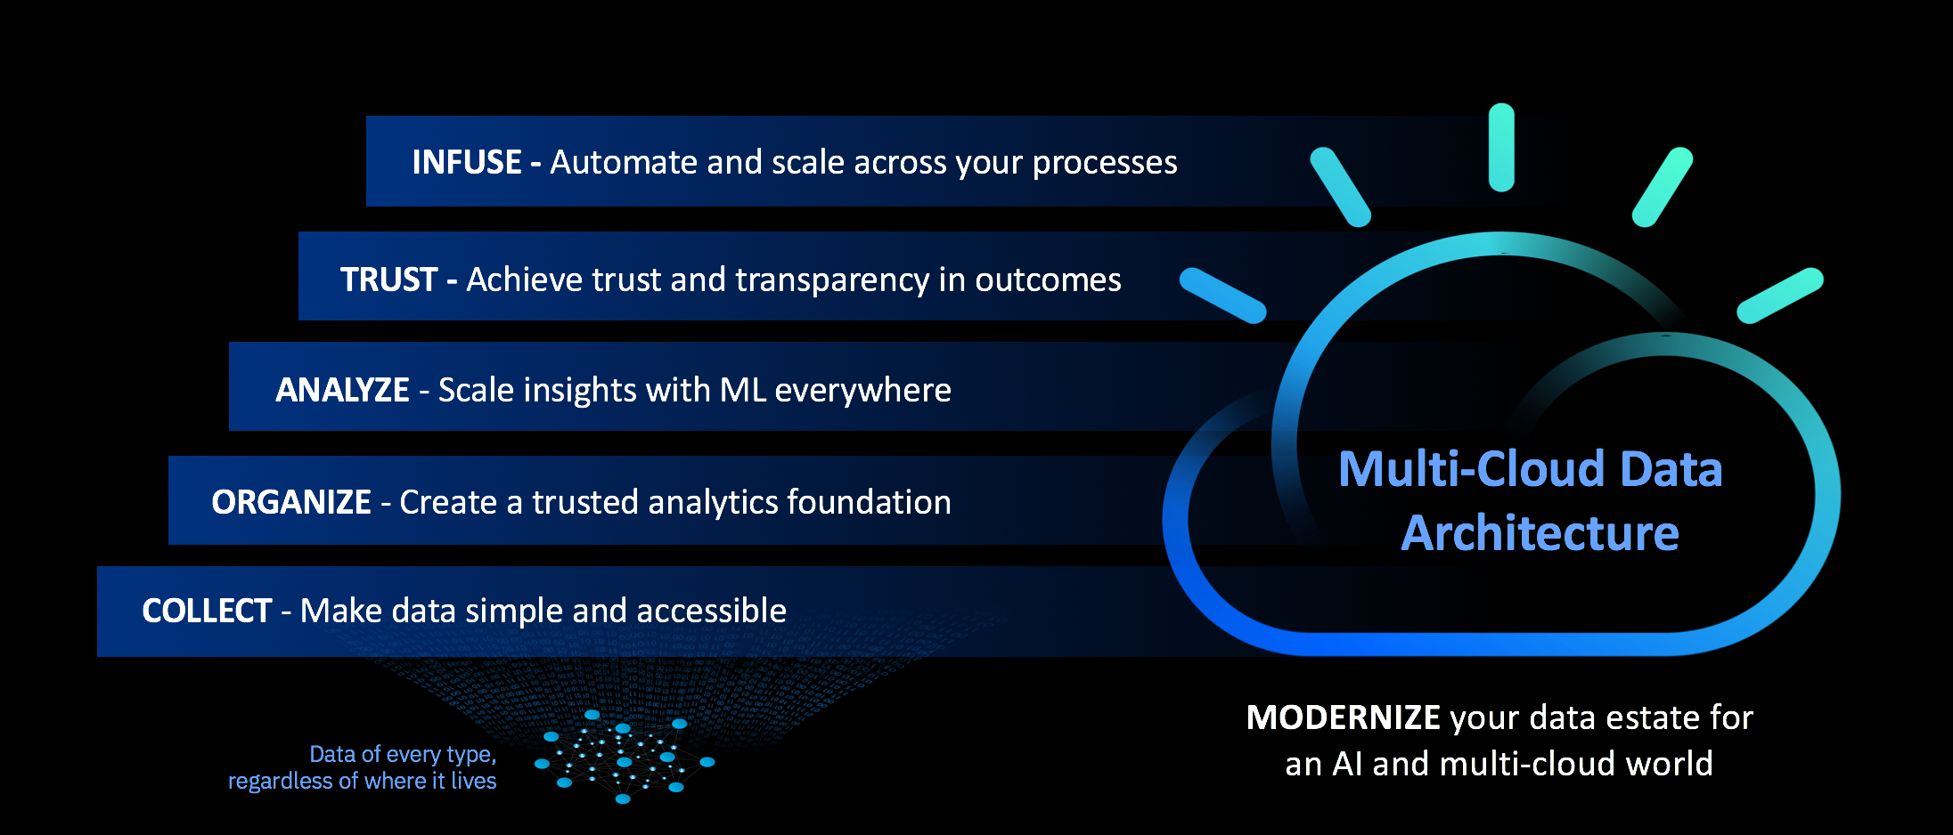




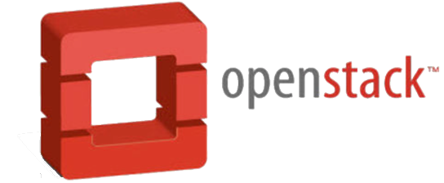
Cloud Pak for Data – Self-serve ready
Foundational “out of the box” multicloud data & AI services
Open, Extensible Platform
Personalized, Collaborative Platform
App Developers
& Analytics Ops
Business Partners
Data Engineers
Data Stewards
Data Scientists
Business Users
The Ladder to AI
APIs
Integrated User Experience
Extensible : “add-ons”, accelerators and Solutions
Modular: - provision services & scale out when needed
Collect & Connect
Organize & Integrate
Analyze & Infuse
Data virtualization
Provision SQL & NOSQL Databases
Warehouses & Marts
Event Ingestion & Streaming Analytics
Distributed compute – Apache Spark
Discovery & search
Data transformation
Data catalogs, quality & Curation
Business glossary
Policies, rules & privacy
Data Science & Visualization
Dashboards & reporting
AUTO-AI, ML deployments & operations
AI Trust and Transparency - Explainability & Bias detection
AI services –Chat, NLU
MODERNIZE your data estate for AI in a multi-cloud world
Core Services
Logging
Monitoring
Metering
Storage Volumes
Auditing
Security
Identity Access Mgmt.
Docker Registry , Helm
IBM Cloud
Hyperconverged System
Notes:
When clients start with IBM Cloud Private for Data, they get the foundational capabilities for the COLLECT, ORGANIZE and ANALYZE rungs on the AI Ladder, all integrated via the flexibility of cloud-native microservices. They can access data, create policy-based catalogs, build open source AI/ML models, visualize data with dashboards, and more. You can think of these capabilities as cloud-native microservice versions of our core offerings (like Db2, InfoSphere, DataStage, Watson Studio, and Cognos Analytics), integrated into a platform. No assembly required.

Slide 30
Supporting the continuum from data collection to consumption Enabling velocity, scalability, and traceability
Data Architects
Data Engineers
Data Stewards
Knowledge Worker
Data Collection
Discover
Understand
Prepare
Consume
Data
Science & AI
Data Virtualization
Industry Models
Policy Activation
Metadata Management
Data Profiling
Business Glossary
Data Cataloging
Search & Understand
Policy Management
ETL
Data Quality
Data Prep
Integration for Productive Use
Data Monetization
Notes:
If we look across the typical Data Management ecosystem we see how the capabilities that we all know and love fit across the personas that are typically involved with the process.
The lighter boxes on the left are where our clients have typically invested to date. Extremely important business critical capabilities that are required to collect, govern and manage data.
The right hand side contains newer areas that are required to put information in the hands of the knowledge worker and allow them to to do something useful with the data in an efficient manner.
All capabilities operate against common metadata that flows through the organization but surfaces up different capabilities through targeted experiences to each persona.
Both the left hand side and the right hand side are growing, but its fair to say that we observe a much higher growth and level of interest in the features on the right hand side as clients look to embrace AI and there is a growing need to understand how to monetize data.

Slide 31
Competitors and differentiators ?

Slide 32
Cloud Pak for Data Data Virtualization Service
IBM Competitive Advantages
Data virtualization in IBM® Cloud™ Pak for Data, is a unique new technology that connects tens to hundreds of data sources into a single self-balancing collection of data sources or databases, referred to as a constellation. An application submits a query that’s processed near the server where the data source exists. Results of the query are consolidated within the constellation and returned to the original application. No data is copied and it exists only at the source.
Our forward facing technology with richness of automation from data discovery to self-service for data preparation with overlay of security and governance support clients on their one single Data Fabric journey on hybrid cloud platform for geographically dispersed sources.. Accelerates their digital transformation in a more efficient, cost effective and seamless manner than our competitors.
#1 Collaborative computing mesh providing scale and performance
Why is it unique: Self organizing peer to peer architecture, applications can query across multiple databases, flat files and big data repositories, individually or collectively. Make many databases — even globally distributed —appear as one to an application. Simplify data analytics with a scalable and powerful Cloud Pak for Data platform. Execution pushed down into the constellation mesh, allowing strong parallel, distributed processing.
#2 Simplicity and Self-Serve capabilities
Why is it unique: Automatically find and match tables across systems so you can query them as a single virtual table. Connect to Data Virtualization with your favorite SQL apps and tools, i.e. RStudio, Jupyter Notebook, Cognos, Tableau, Microstrategy
#3 Security and Governance
Why is it unique: Centralize and strong access control and governance. Fully encrypted communication. Governance through single data catalog (metadata repository) on the Cloud Pak for Data platform
#4 Query across multiple data sources
Why is it unique: Supports Oracle, Db2, SQLServer, Informix, Netezza, MySQL, PostgreSQL, Big SQL, Apache Hive, HDP Hive, Cloudera Impala and more. Adding data source is easy across regions.
Competitive Landscape (key ones)
Denodo-
Who are they: Denodo is a private company, still VenCap funded, revenues ~$50M, Data Virtualization focused
Why a threat: Recognized market leader, present in much of our client base, growing 60%+ annually
Main strength(s): Rich GUI, robust set of data source support, graphical support for building views, some key features (e.g., caching and data masking) that are on our roadmap for 2H,19. Conceptually builds a virtual data warehouse.
Main weakness(es): Some auto discovery, limited in scalability, still heavily reliant on centralized processing and hub and spoke model. Starting 2H’19 with integration of Watson Knowledge Catalog on CP4D and DV we will have very strong governance support, from business glossary, data privacy & protection rules to data lineage
TIBCO -
Why a threat: Tibco has strong install base in Financial Services, but growth stalled under Cisco till recently when it came into TIBCO
Main strength(s): Appear to be integrating DV into their Spotfire Analytics Platform
Main weakness(es): Still to gain momentum back & lack of end to end solution
Responding to Objections IBM Cloud Pak for Data is Industry leader in an end to end Data and AI platform allowing to simplify Data and AI, digital transformation journey. IBM has invested heavily in, custom user experience for all user persona’s in an enterprise for a simplified self-serve experience. The platform is ready to help clients with their Data compliance and security journey to counter today’s compliance needs. Data Virtualization data source support is growing everyday, and a comprehensive list of sources are on our roadmap. Also, IBM is ready to prioritize the sources for a client opportunity. While these IBM competitors offer only point to point solution, IBM differs in its ability to provide an end to end solution for Data and AI Journey with built-in governance.
IBM Data & AI /© 2019 IBM Corporation
IBM Internal ONLY

Slide 33
Competitive landscape matrix
Feature (reference from previous page) | Data Virtualization Service | Denodo | TIBCO
Collaborative computing (#1) | IBM Cloud Pak for Data | ▲ | ▲
Simplicity (#2) | IBM Cloud Pak for Data | ◼︎ | ▲
Centralized Governance and One Catalog (#3) | IBM Cloud Pak for Data | ▲ | ▲
Security (#3) | IBM Cloud Pak for Data | ◼︎ | ▲
Rich Application / Self-Server Capabilities (#2) | IBM Cloud Pak for Data | ▲ | ▲
Data Source Support (#4) | IBM Cloud Pak for Data | ▼ (they have ten years lead, we are quickly adding new sources, also IBM DV can work easily with geographically dispersed sources) | ◼︎
Optimized Performance (#1) | IBM Cloud Pak for Data | ▲ | ▲
▲ IBM shows a favorable comparison
▼ Competitor shows a favorable comparison
◼︎ About the same comparison
Other Vendors - Astera Software, Cambridge Semantics, Data Virtuality, Dremio, EQ Technologic, fraXses, Gluent, Marklogic, Microsoft PolyBase, SAP Smart Data Access, Stone Bond, and Teradata QueryGrid.
IBM Data & AI / © 2019 IBM Corporation
IBM Internal ONLY
Notes:
<SECOND PAGE: OPTIONAL>
Competitive Landscape Matrix
This slide provides a quick-glance view of the IBM solution’s positioning against all the competitive players in the space. List the competitors against the key features or benefits that are most important to the target buyer and copy and paste the appropriate symbols into each table cell to
indicate which solution delivers against which benefit.
This is a high-level overview only. The full Competitive Playbook will enable you to drill into how IBM maps against each competitor and
provide concrete guidance on how to sell against each.
<Below is the standard disclaimer copy. Other legal messages are needed in some instances so be sure to check legal guidance for each asset to see what else you should include. Full guidance is available here (IBM login required): https://w3-connections.ibm.com/wikis/home?lang=en-us#!/wiki/Wf56de6c7e2e2_46bd_be6f_880f8c82e23e/page/Attachment%20A.%20Corporate%20Disclaimer>
© Copyright IBM Corporation 2019. [IBM Business Unit], New Orchard Road Armonk, NY 10504 . Produced in the United States of America, [Month] 2019. IBM, the IBM logo, and ibm.com are trademarks of International Business Machines Corp., registered in many jurisdictions worldwide. Other product and service names might be trademarks of IBM or other companies. A current list of IBM trademarks is available on the web at “Copyright and trademark information” at www.ibm.com/legal/copytrade.shtml. This document is current as of the initial date of publication and may be changed by IBM at any time. Not all offerings are available in every country in which IBM operates.
The performance data and client examples cited are presented for illustrative purposes only. Actual performance results may vary depending on specific configurations and operating conditions.
THE INFORMATION IN THIS DOCUMENT IS PROVIDED “AS IS” WITHOUT ANY WARRANTY, EXPRESS OR IMPLIED, INCLUDING WITHOUT ANY WARRANTIES OF MERCHANTABILITY, FITNESS FOR A PARTICULAR PURPOSE AND ANY WARRANTY OR CONDITION OF NON-INFRINGEMENT. IBM products are warranted according to the terms and conditions of the agreements under which they are provided.
The performance data and client examples cited are presented for illustrative purposes only. Actual performance results may vary depending on specific configurations and operating conditions.
<If compliance is mentioned in the document, include this additional disclaimer copy>
The client is responsible for ensuring compliance with laws and regulations applicable to it. IBM does not provide legal advice or represent or warrant that its services or products will ensure that the client is in compliance with any law or regulation.
<If any statements about the future are made in the document, include this additional disclaimer copy>
Statements regarding IBM’s future direction and intent are subject to change or withdrawal without notice, and represent goals and objectives only
Update this to reflect the main BU featured in the document
Update this to reflect the date of publication

Slide 34
CP4D Experiences

Slide 35

Your digital selling toolkit
Glimpse into key product features
VIDEO DEMOS
Experience functionality interactively
PRODUCT TOURS
Discover ’Wow’ moments in 5 minutes or less with LIVE product
CLOUD PAK EXPERIENCES
Hosted environments give clients hands-on access to test drive IBM Cloud Paks
Guided flows step users through example scenarios
Users can explore the full live product on their own or with sales guidance
7 days of access, with the option to extend to 14 days
Learn a concept with in-depth of tasks and steps
HANDS-ON LABS

Slide 36





Sales stages to use Cloud Pak Experiences
4 Validated / Qualifying
5 Qualified / Gaining Agreement
6 Conditional Agreement / Closing
7 Won / Implementing
Clients can discover & explore use cases independently (inbound marketing)
In person or virtual demo (before a full POC/ POT)
Take on the road and show on the fly at an event
Use as a tool to gauge client interest across department and divisions
Socialize Pak value among stakeholders within an account
Pro Tips
Pre-loaded flows highlight key value propositions and common scenarios.
Go “off-script” to craft a personalized message for your client’s needs.
Share digitally, on the road, or in a meeting. (Firefox and Chrome are recommended.)
Client wins with Cloud Pak Experiences

Slide 37
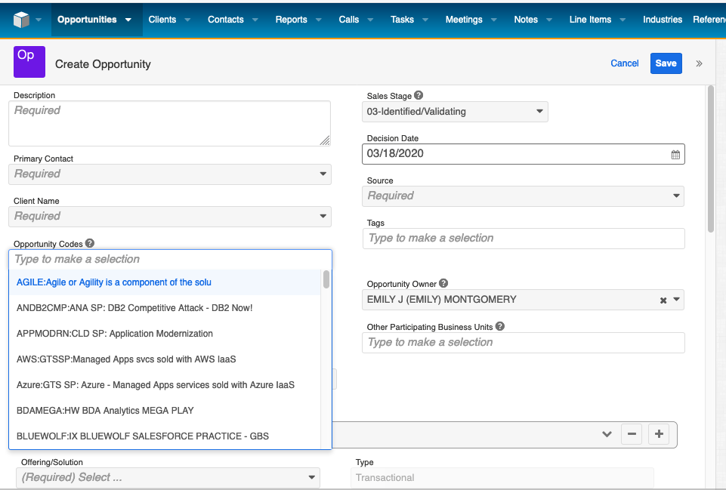
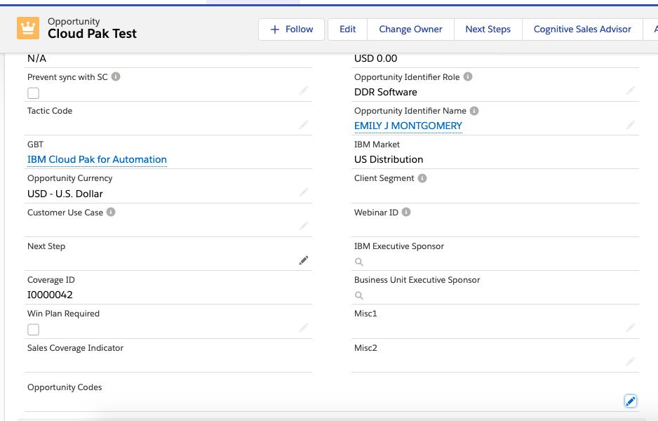
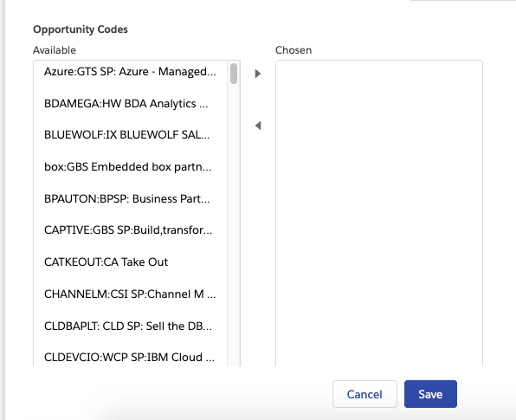
Add an Opportunity Code to New or Existing Opportunities
Cloud Pak Experiences
SalesConnect
Salesforce (GAIA)
In the “Opportunity Codes” field, type ‘Pak’ to make a selection.
Find “CLDPAKEX: Cloud Pak Experience”.
Click Save after you have entered all the other required/known values.
A
Fill the required/known fields and click Save.
Scroll to the Opportunity Codes field and click the Edit (pen) icon.
B
On the next screen, scroll through the Available pick-list and find “CLDPAKEX: Cloud Pak Experience”.
Add it to the Chosen list, and then click Save.
B
CLDPAKEX: Cloud Pak Experience
CLDPAKEX: Cloud Pak Experience
A

Slide 38

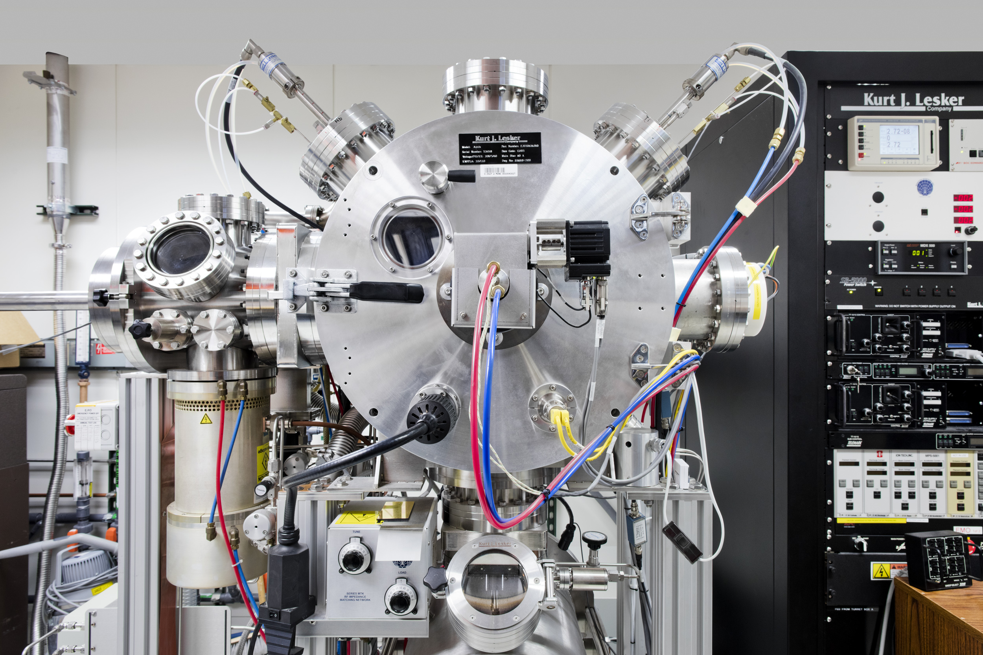


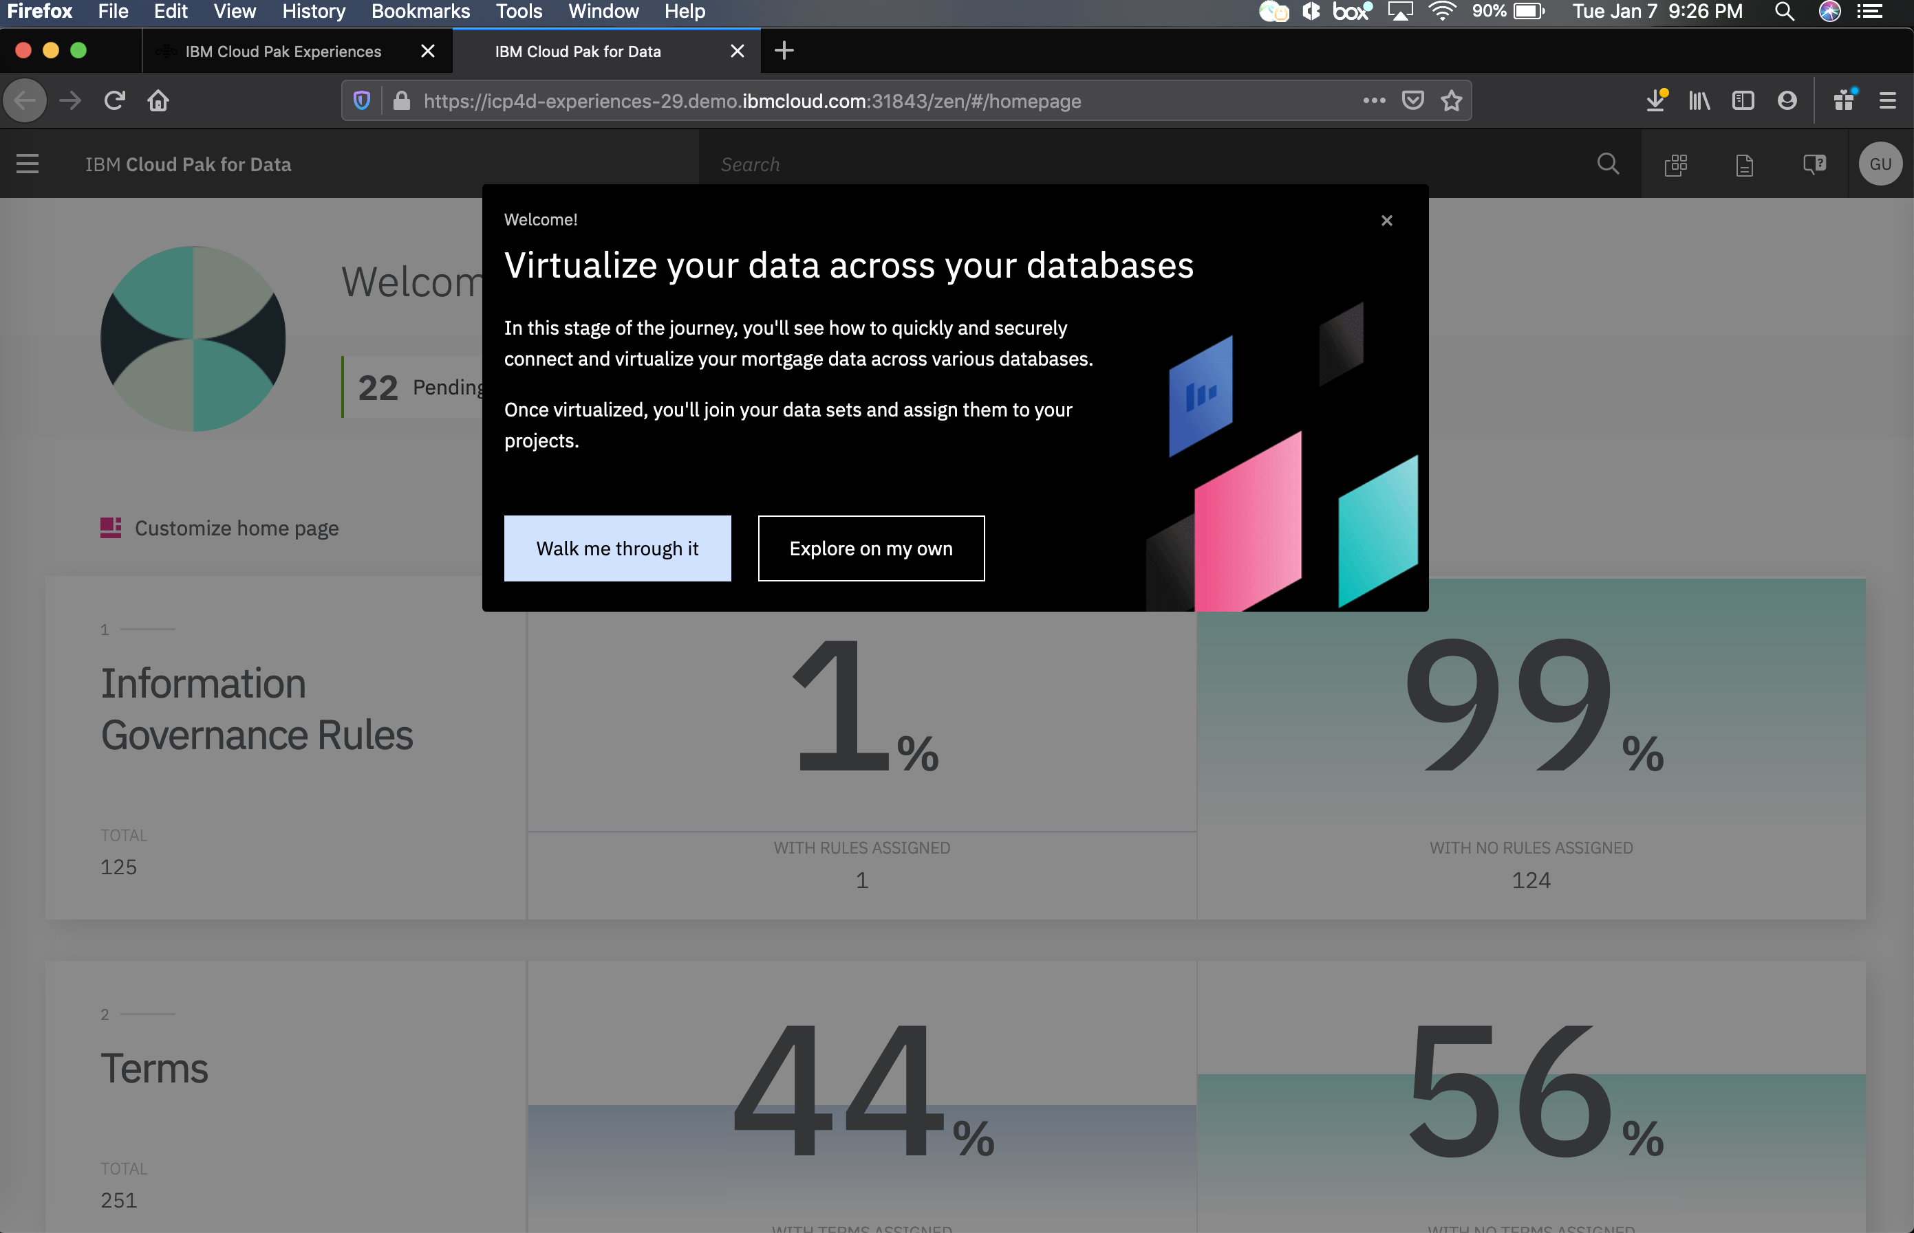
Get Started With Cloud Pak Experiences
Ask questions, get help, or share feedback:
#experiences-sales-insights
ACCESS TODAY ibm.com/cloud/paks/experiences
RELEASE SCHEDULE
Cloud Pak for Data
Collect & Virtualize Available now!
Organize Available now!
Analyze Available now!
Update for version 2.5 Coming 26-Jan
Updated flow for Organize Coming 26-Jan
Updated flow for Analyze Coming 26-Jan
Cloud Pak for Automation
Capture data Available now!
Manage content Coming 14-Feb
Cloud Pak for Applications
Assess cloud readiness Coming 17-Jan
Build cloud native TBD
CONTACT US
Elizabeth Silberg Director, IBM Cloud Paks Digital silberg@us.ibm.com
Travis Roache Digital Offering Manager, Cloud Pak Experiences
tgroache@us.ibm.com
Justin Herberger Digital Offering Manager, Cloud Pak Experiences
justin.herberger@ibm.com
IBM Cloud / DOC ID / Month XX, 2019 / © 2019 IBM Corporation

Slide 39
Additional Resources:
IBM Cloud Pak for Data
CP4D Data Virtualization
Digital Technical Engagement – Cloud Pak for Data
Data Virtualization Manager for z/OS
DVM Homepage
Digital Technical Engagement - DVM

Slide 40
Supplemental

Slide 41


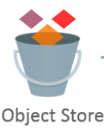


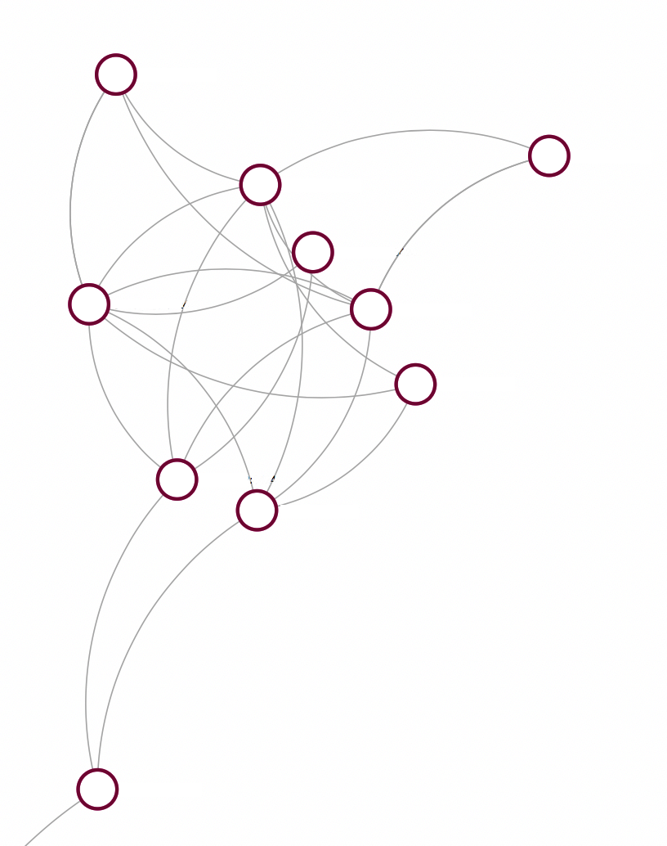
Architecture
Common SQL Engine
Administration UI
Client Applications
S3…
Remote Source Connector
Remote Source Connector
Remote Source Connector
Governance included within CP4D
Network
Oracle
Sybase
Adjacent to data
MS SQL Server
Netezza
(PDA)
OPTIONAL installation of Remote Agent
Remote Agent
Remote Agent
OPTIONAL installation of Remote Agent
SparkSQL
Information Governance (existing at remote Data Source)

Slide 42
Bringing parallelism to each data source.
Traditional processing queries the data source (on right) then processes large results on a single thread (executor) on left.
Solution: Data Virtualization queries data source (on right). Merges results in many parallel threads on left by leveraging parallel read streams.
Data
Source
64 core
Single channel is bottleneck for any large result set. Data Virtualization resolves this through parallel read from sources.

Slide 43
Efficient Cross Source Joins
Oracle
Marketing db
1MB
Problem: Joining data between multiple databases is a common pattern, but brutally slow. With traditional processing, data from both tables is shipped over the network to the server, where the join is processed.
Solution: Data Virtualization uses the early filtering techniques to dramatically reduce transmission costs. Data from the smaller table (inner) is used to build a small filter query that is applied to the larger (outer) table before data is transmitted. In many cases this is 85% effective at filtering data that will be removed by the join before the join is processed, leading commonly to a ~10x acceleration.
64 core
Db2
Sales db
50GB

Slide 44
20 databases? Traditional processing gets worse as the number of databases increases
Other
64 core
Informix
Informix
Db2
Informix
Informix
Oracle
Simultaneous processing and parallel fetch continues to scale up.
Data Sources
Informix

Slide 45
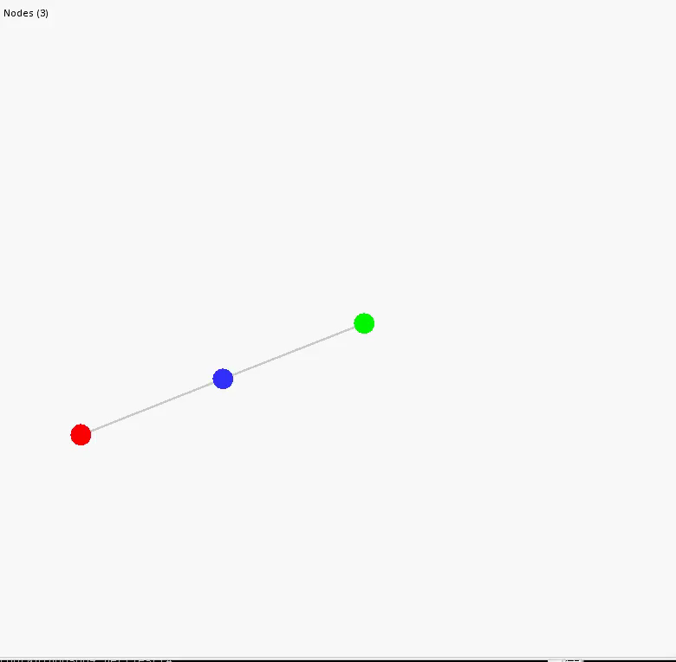
Real System test Growing a Constellation
Video of constellation growing to 349 Nodes.
Network stays compact.
2 and 10 links between nodes
No manual configuration.
Latency aware connection between nodes
Which nodes connect to which others?
Fastest reply strategy
Diameter of the constellation (i.e. the number of hops between the two furthest nodes) grows logarithmically. Small diameter is ideal for communications.
Actual system test performed by Emerging Technology Services, IBM Hursley, United Kingdom

Slide 46



Smart Query Processing
IBM Data Virtualization reduces query time by using Parallel Processing, Pushdown Optimization and Connection Pooling
Read total quantity
sold in Hawaii
Query Results
in 1/3 the time!
Total quantity sold across 3 states
Order by quantity, return top 10 products
Read total quantity
sold in California
Read total quantity
sold in New York
Data Virtualization
Others
Timeline
Read total quantity sold in Hawaii
Read total quantity sold in California
Read total quantity sold in New York
Order by quantity, return top 10 products
Total quantity sold across 3 states
Notes:
Using harden technology from IBM’s Enterprise Database team, with advancements from IBM Research, our Data Virtualization (DV) engine is able to rapidly deliver query results from multiple Data Sources by leveraging advanced parallel processing and pushdown optimization
Not only is Data Virtualization (DV) fast, DV removes complexity when querying information from multiple Data Sources.
Rapidly query, consolidate, sort and report information from a handful to thousands of unique Data Sources (DS) using one SQL statement
that uses Virtual Table(s) (VT). Each VT refers to one or more actual Data Sources and Tables.
Queries can combine data from a multiplicity of sources including relational databases, spreadsheets, and flat files

Slide 47
DV Engine Generated SQL for Distribute Aggregation
Original
SELECT COUNT(PROMOVALUE2) FROM PROMOTION
Remote SQL
SELECT SUM( A0.C0)
FROM (
SELECT A1.C0 C0
FROM new com.ibm.db2j.GaianQuery(
'SELECT COUNT( A2."PROMOVALUE2") C0
FROM new com.ibm.db2j.GaianTable(
''PROMOTION'',
''SOURCELIST=(MYSQL10000:"POPS_node1", MYSQL10001:"POPS_node2",
MYSQL10002:"POPS_node3", MYSQL10003:"POPS_node4",
MYSQL10004:"POPS_node5")'',
''"PROMOKEY" INTEGER, "PROMOTYPE" INTEGER, "PROMODESC" CHAR(30),
"PROMOVALUE" DECIMAL(5, 2), "PROMOVALUE2" DECIMAL(5, 2),"PROMO_COST" DECIMAL(9, 2)''
) A2',
'GAIAN_EXTENDER=[pAgg]','',
'C0 DECIMAL(5, 2)') A1
) A0

Slide 48
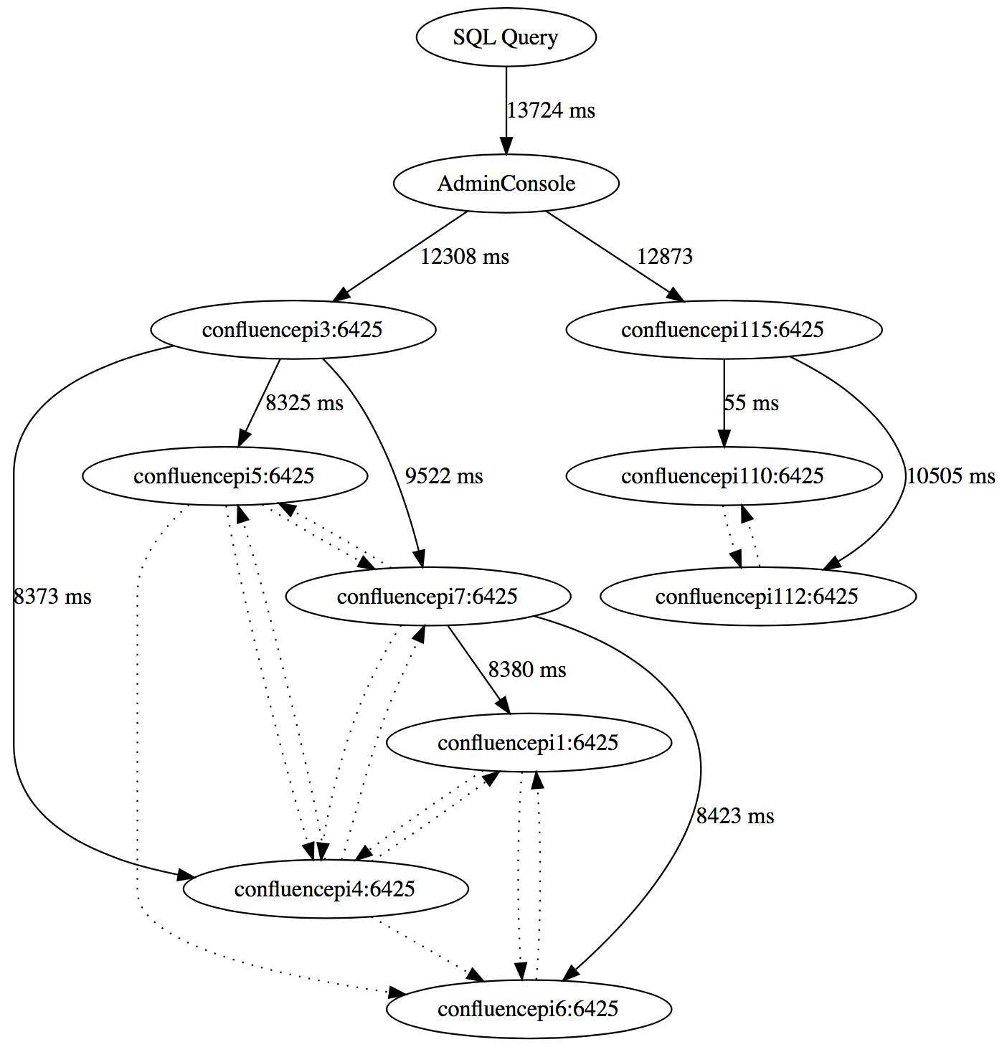
Query Processing in the Constellation
Toronto
San Hose
United Kingdom
Toronto
Fixed execution within the constellation is impossible because of the highly dynamic nature of the network.
Each node instead simultaneously sends the relevant portions of the query to both the connected data source to it’s peers in the network.
Combines and process the results as they are received.
Duplicate results are avoided by a given node only returning results to the first peer that requested them.
Implicitly results in balanced processing of the query through the constellation.

Slide 49
Language Translation in Data Virtualization
Broad set of data sources supported by Data Virtualization each with unique syntax variations.
Constellation is not limited only a single data source type. A logical schema is created across all connected sources.
Multiple levels of translation as we move from the applications through the constellation down to the data source.
User Application
JDBC, ODBC, R, Python, etc
DV Service
Embedded Db2
DV Remote Connector
Translates from received SQL to data source dialect.
Remote Data source
Supports major language variations, SQL, Oracle SQL, Netezza, etc
Compensate for missing functionality.
Db2, Oracle, MySQL, Excel, CSV, etc.

